Slide 1
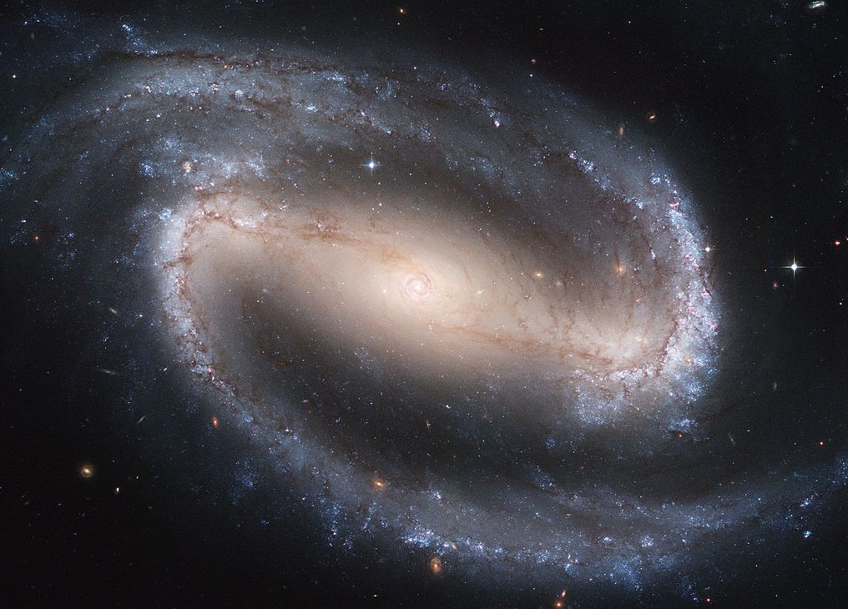
Modern Science and Christian Religion
3 – A Cosmic Desiger:
Evolution and the Multiverse

Slide 2
Revision
We all agree – things need explaining
that’s why we do science
So it’s all over for the atheists!
If a thing needs explaining, the explanation exists
If the explanation needs explaining, got to look for a further explanation …
Even an infinite chain of contingent causes needs still a cause!

Slide 3
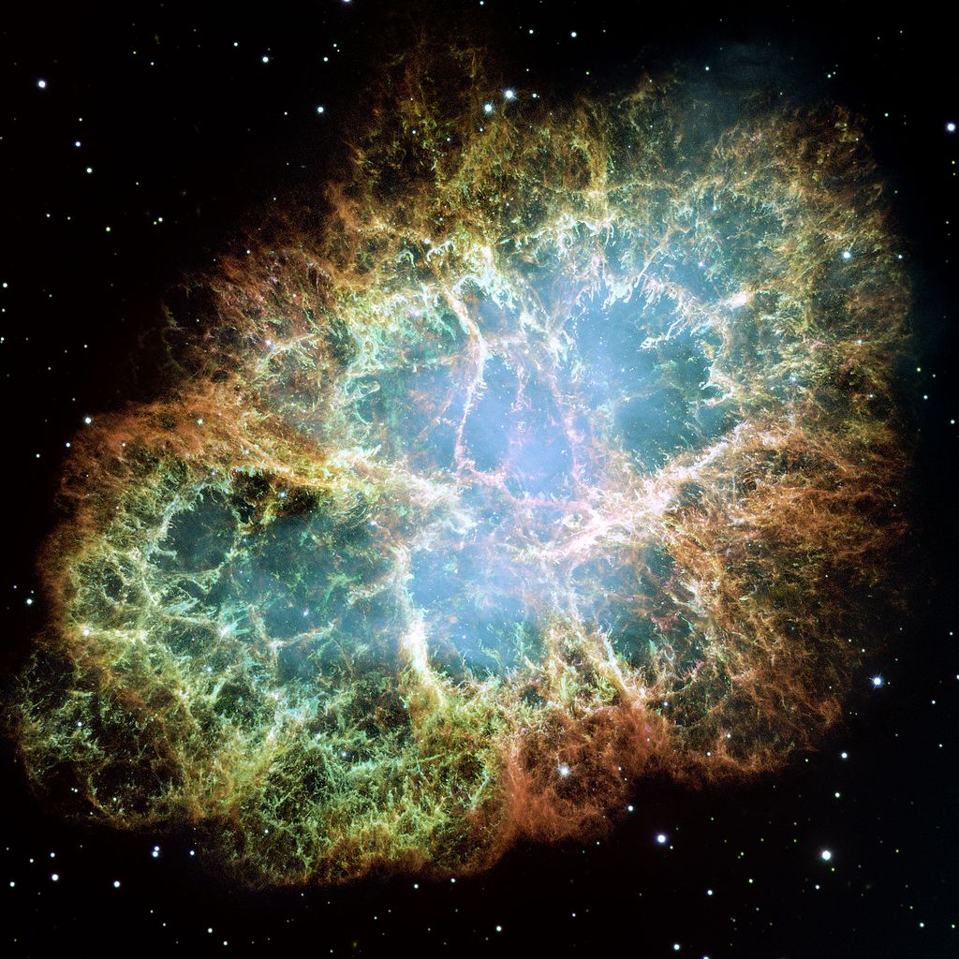
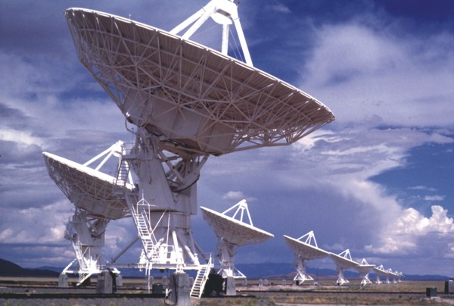
Revision
Just doing cosmology means the universe needs explaining
So the universe is NOT the ultimate cause
It must be God or the law(s) of science
Or are they the same thing?

Slide 4
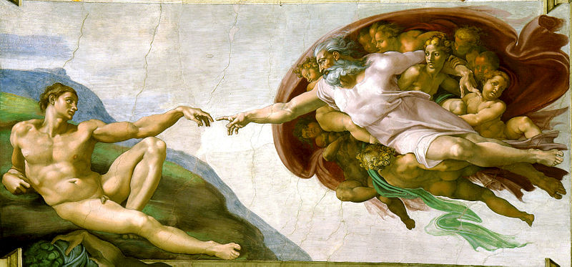
Revision
One important question remains:
Is the First Cause really God?
a Personal God? – knowing and loving?

Slide 5
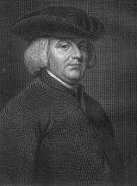
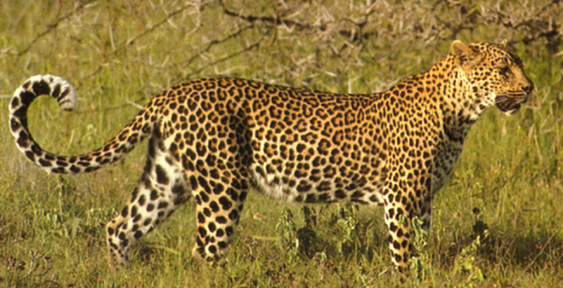
A Designer God?
William Paley (1743-1805)
Suppose you find a stone on a heath
Maybe it has always been there
Suppose you find a watch on a heath
It is so complex, it must have been designed
Suppose you find living things
Much more complex than a watch
They must have been designed … by God
A God of the Gaps
And Darwin filled the gap (?)

Slide 6
The Origin of Life
Miller and Urey (1952)
CH₄
NH₃
H₂O
Amino Acids

Slide 7
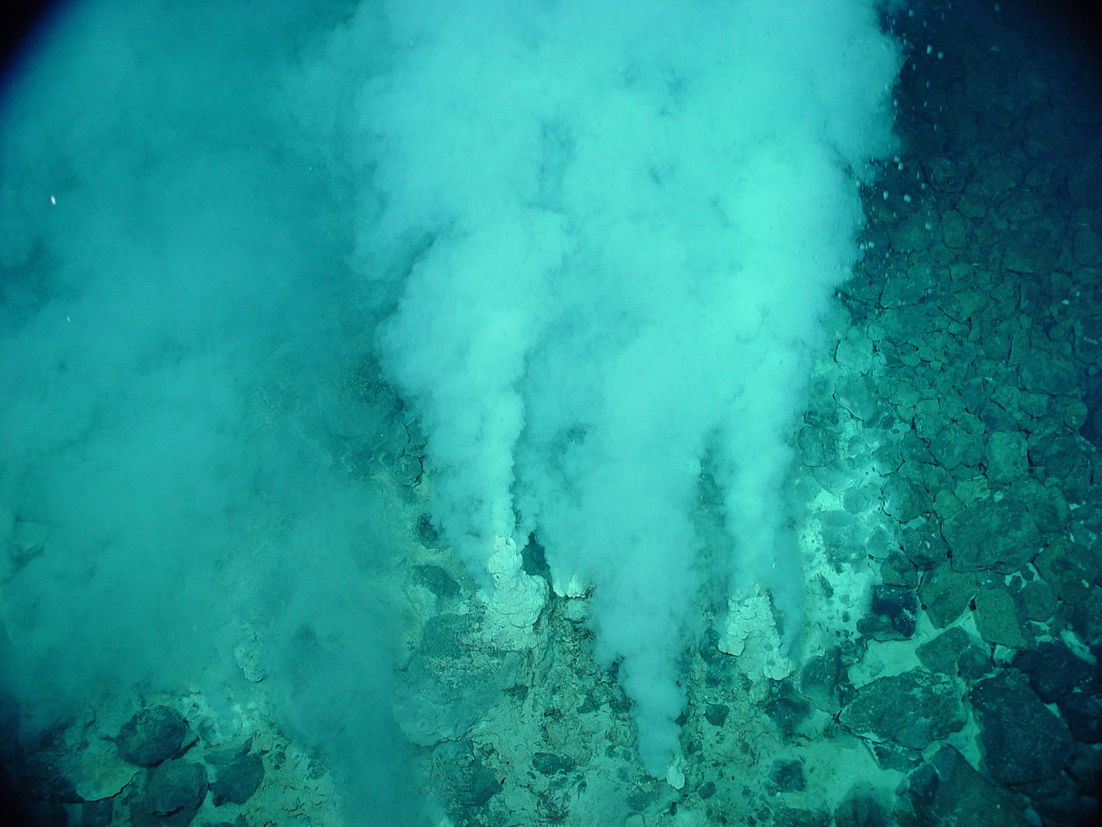
The Origin of Life

Slide 8
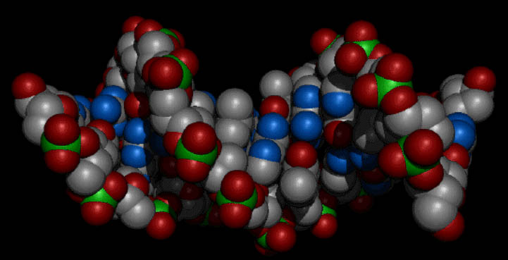
Neo Darwinism
Evolution by natural selection (Darwin)
+ Genetics (Mendel)
+ Biochemical basis (Crick and Watson etc.)

Slide 9
DNA structure & reproduction
A
C
G
T
C
C
A
G
T
G
C
A
G
G
T
C

Slide 10
C
C
C
A
G
T
G
A
C
G
T
T
G
C
A
C
A
G
G
T
C
G

Slide 11
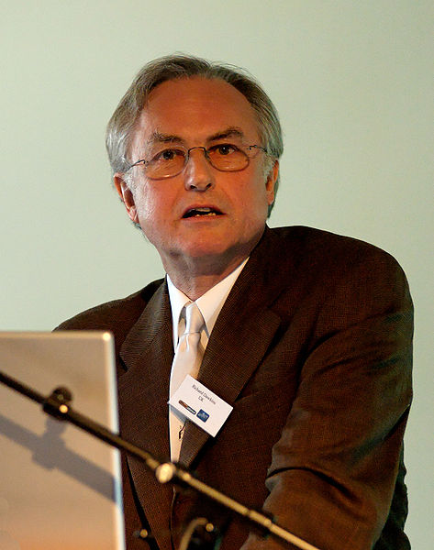
Comments on Darwinism
Evolution is NOT random
“One of my tasks will be to destroy this eagerly believed myth that Darwinism is a theory of ‘chance’.”
Richard Dawkins, The Blind Watchmaker, p. xv
The are many difficulties to overcome

Slide 12
Scientific Status of Evolution
Is the logic sound?
Yes
Have we observed natural selection?
Yes
Has life on earth actually evolved?
Yes
Evidence for evolution
fossil record
vestigial structures
“design faults”
shared biochemistry

Slide 13
Scientific Status of Evolution
Does Neo-Darwinism account for all evolution?
probably for most
but all scientific theories can be modified
that’s how science works
If Darwin’s theory turns out to fail, we should look for another natural, scientific explanation

Slide 14
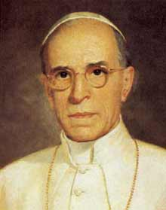
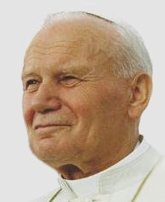
Theological Status of Evolution
The teaching of the Church does not forbid that the doctrine of evolutionism, in so far as it inquires into the origin of the human body from already existing and living matter, be … treated in research and discussion by experts on both sides; as to the souls, the Catholic faith demands us to hold that they are immediately created by God.
Pius XII, Humani Generis 36
New knowledge has led to the recognition of the theory of evolution as more than a hypothesis.
John Paul II, To Pontifical Acad. of Sci. 1996

Slide 15
Theological Status of Evolution
The question about the origins of the world and of man has been the object of many scientific studies which have splendidly enriched our knowledge of the age and dimensions of the cosmos, the development of life-forms and the appearance of man. These discoveries invite us to even greater admiration for the greatness of the Creator.
Catechism of the Catholic Church 283

Slide 16
Theological Status of Evolution
The biblical account expresses this reality in symbolic language when it affirms that ‘then the Lord God formed man of dust from the ground, and breathed into his nostrils the breath of life; and man became a living being.’ [Gen 2:7].
Catechism of the Catholic Church 362

Slide 17
St Augustine on Genesis
Gen 1 and Gen 2 do not simply agree
Gen 1 (6 days)
God creates invisible, “rational seeds” or causes
Gen 2 (after the 6 days)
Normal, visible forms brought forth
Under God’s providence
Through appropriate environmental conditions

Slide 18
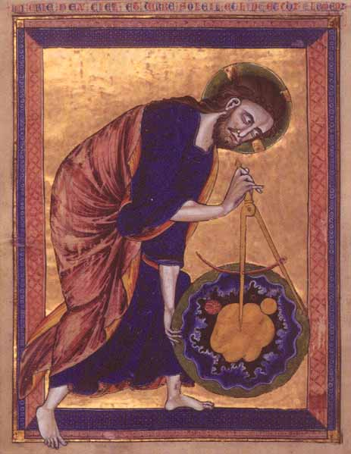
Is there a Personal Designer God?

Slide 19
“Anthropic Coincidences”
Or: Cosmological life-supporting coincidences
3 space dimensions
Or planetary orbits are unstable
Mass of proton ≈ Mass of neutron
Or only hydrogen or neutron stars
Strength of strong nuclear force
10% weaker → only hydrogen
4% stronger → stars burn to fast for life to evolve

Slide 20
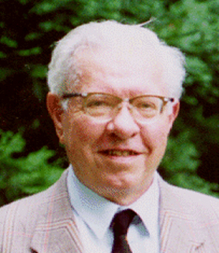
“Anthropic Coincidences”
Right ratio of strong force to electromagnetic
Balanced to within 1%
Allows a “resonance” of Carbon-12
Otherwise only H and He
“The universe is a put-up job”
Balance of Dark Energy

Slide 21
Dark Energy of the universe is right to one part in:
100,000,000,000,000,000,000,000,000,000,
000,000,000,000,000,000,000,000,000,000,
000,000,000,000,000,000,000,000,000,000,
000,000,000,000,000,000,000,000,000,000
= 10¹¹⁹
= ten billion billion googol

Slide 22
“A careful study suggests that the laws of the universe are remarkably felicitous for the emergence of richness and variety. In the case of living organisms, their existence seems to depend on a number of fortuitous coincidences that some scientists and philosophers have hailed as nothing short of astonishing.”
Paul Davies, The Mind of God p. 195

Slide 23
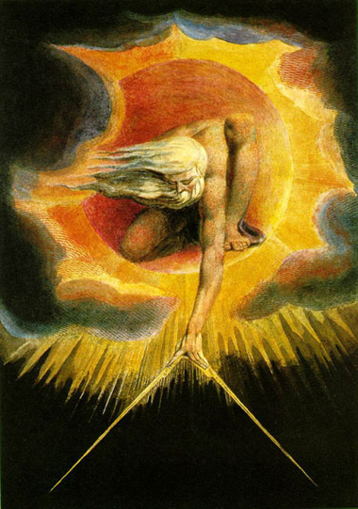
Designer God or Multiverse?

Slide 24
Multiverse Theory

Slide 25
Multiverse Theory
A scientific multiverse gets us nowhere!
Explains why some “universes” support life
Does not explain why the multiverse supports life
The real universe is just bigger than we used to think!
The multiverse IS the REAL universe

Slide 26
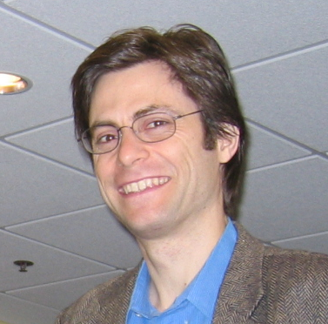
Multiverse Theory
Other possible scenarios?
There is only one mathematically possible universe?
The universe needs to be observed to exist?
Every mathematically possible universe exists?
There “just are” many universes
equals giving up on science

Slide 27
Conclusion
A personal designer (God)
Contingency (science)
→ First Cause
Life-friendly universe (science)
→ First Designer

Slide 28
Conclusion
Task of intelligent person:
explain the explainable
recognise the mystery of the unexplainable
not to mix these up!
The universe is explainable
equals science
The Mystery—the Ultimate Explanation—is something else

