Slide 1
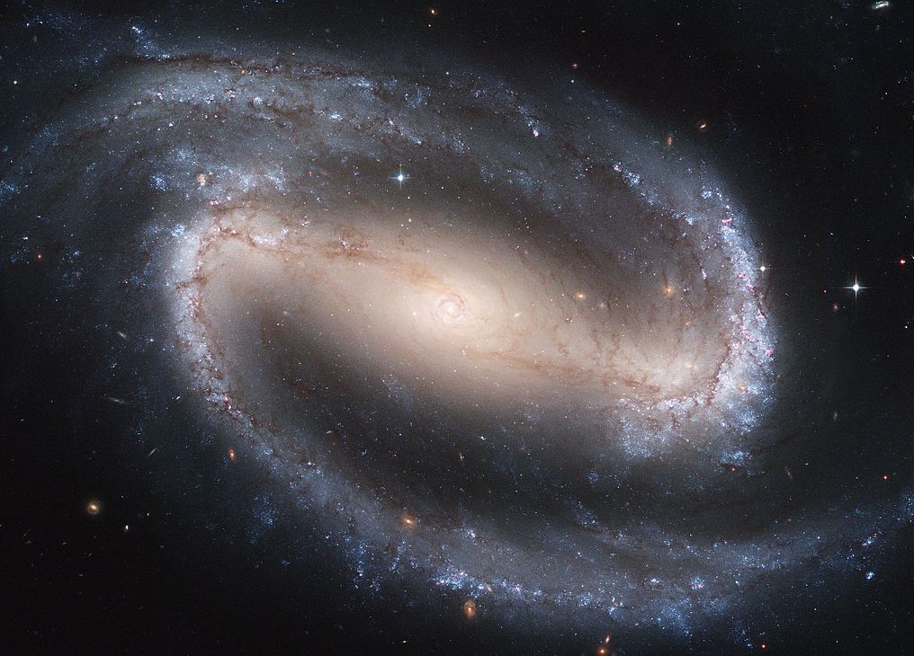
Modern Science and Christian Religion
1 – The Myth of Conflict:
Galileo and the Bible

Slide 2
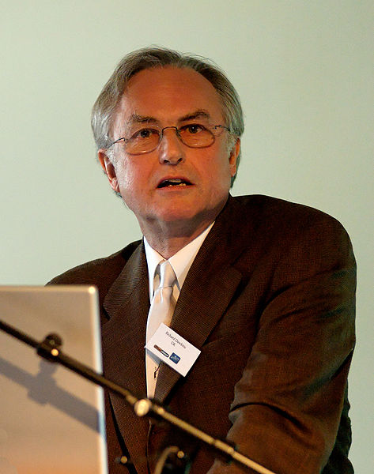
“I could not imagine being an atheist at any time before 1859, when Darwin’s Origin of Species was published. … Darwin made it possible to be an intellectually fulfilled atheist.”
Richard Dawkins,
The Blind Watchmaker, p. 7

Slide 3
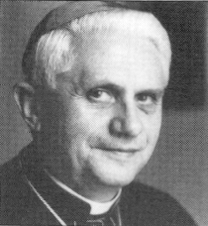
Philosophy, “logos”, reason
Ancient Greek / Roman religion
myth, piety

Slide 4
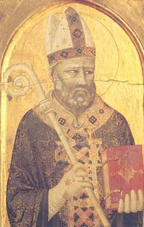
“Usually, even a non-Christian knows something about the earth, the heavens, and other elements of the world … Now it is a disgraceful and dangerous thing for an unbeliever to hear a Christian, presumably giving the meaning of Holy Scripture, talking nonsense on these topics … If they find a Christian mistaken in a field which they themselves know well and hear him maintaining his foolish opinions about our books, how are they going to believe these books in matters concerning the resurrection of the dead, the hope of eternal life, and the kingdom of heaven …?”
St Augustine, De Genesi ad Litteram, bk 1, ch 19

Slide 5
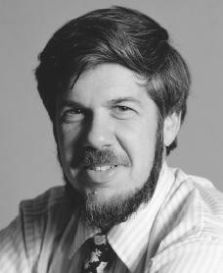
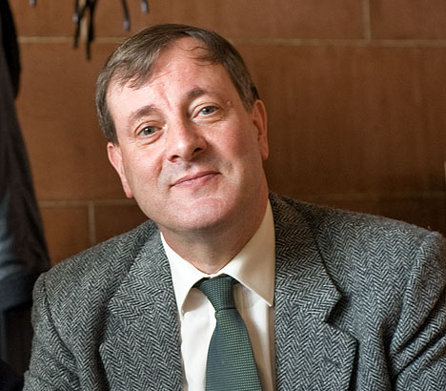
Relationship of Science & Religion
Conflict
Independence
Dialogue
Integration

Slide 6
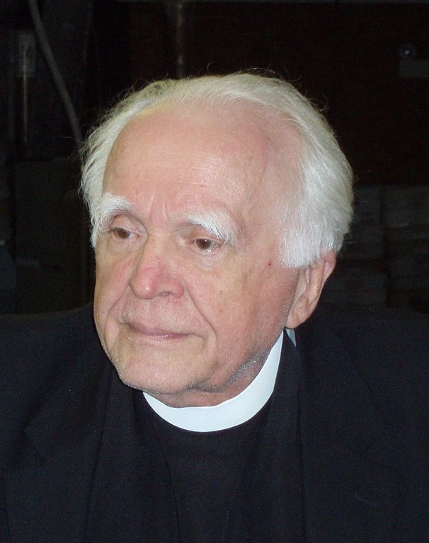
Christianity Got Science Going
Pagan religions
world is evil
world is chaotic
world is divine
Christianity
world is created
world is good
world is ordered
God has given us dominion

Slide 7
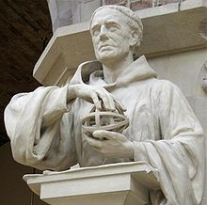
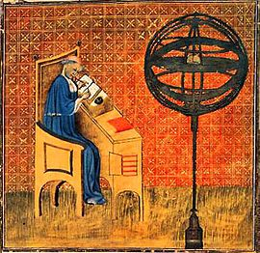
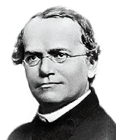
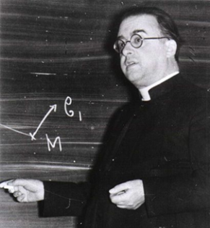
Position of the Catholic Church
Roger Bacon
Franciscan friar
Experimental method
Nicole Oresme
Bishop
Rotation of the Earth
Gregor Mendel
Augustinian monk
Genetics
Georges Lemaître
Priest
Big Bang theory

Slide 8
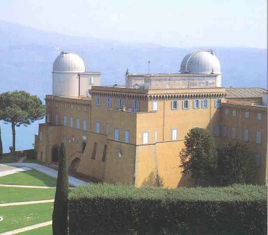
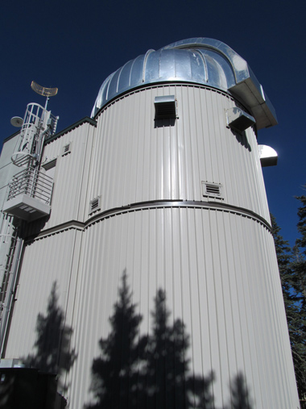
The Vatican Observatory

Slide 9
Official Church Teaching
“There can never be a real discrepancy between faith and reason, since the same God who reveals mysteries and infuses faith has bestowed the light of reason on the human mind, and God cannot deny Himself, nor can truth ever contradict truth.”
Vatican I, Dei Filius (1870)
“If anyone says that the One true God, our Creator and Lord, cannot be known with certainty with the natural light of human reason through the things that are created, anathema sit.”
Vatican I, Dei Filius (1870)

Slide 10
Official Church Teaching
“Scientific studies … have splendidly enriched our knowledge of the age and dimensions of the cosmos, the development of life-forms and the appearance of man. These discoveries invite us to even greater admiration for the greatness of the Creator.”
Catechism of the Catholic Church 283

Slide 11
The Galileo Affair
Ptolemy (2nd century)
Copernicus (1473-1543)

Slide 12
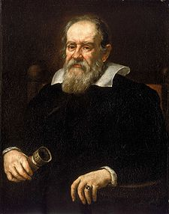
Galileo (1564-1642)
Moons orbiting around Jupiter
not everything orbits the earth
Mars & Venus vary in apparent size
They orbit the sun, not the earth
Copernicus was right

Slide 13
Copernicus’s view seems to contradict Scripture
Ps 92(93):1
The world you made firm, not to be moved.
Ps 18(19):5
There he has placed a tent for the sun.
Josh 10:13
[during a battle] the sun stood still …

Slide 14
Both sides agreed that science cannot contradict Scripture
Galileo
“The motion of the earth could never be against Scripture, if this proposition were correctly proved.”
Cardinal Bellarmine
“If there were a true demonstration that the sun is in the centre of the universe then one would have to proceed with great care in explaining the Scriptures that appear contrary.”

Slide 15
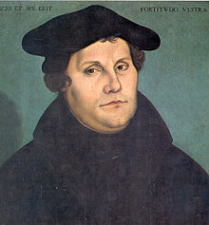
The Complicating Factor: Luther and the Reformation
Luther
Rejected the authority of the Church to give the true interpretation of Scripture
Galileo
Seems to be telling the Church how to interpret the Bible
No wonder he got into trouble!

Slide 16
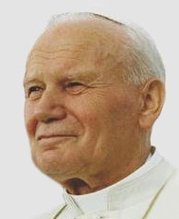
Galileo and the Inquisition
1616
Inquisition orders Galileo not to hold, teach or defend Copernicanism
1632
Galileo publishes “Dialogue Concerning the Two Chief World Systems”, defending Copernicanism
1633
Inquisition orders Galileo to affirm publicly that the earth does not move
Galileo placed under house arrest
1992
John Paul II apologises for how the Church
treated Galileo

Slide 17
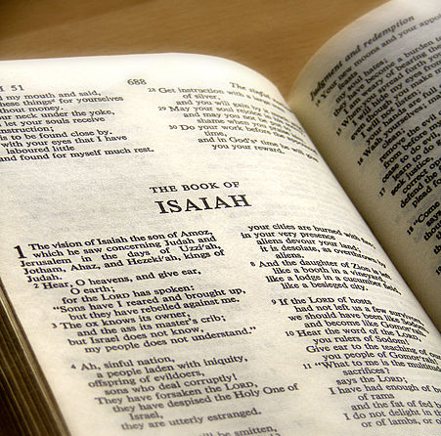
The Issue of Fundamentalism

Slide 18
The Issue of Fundamentalism
Seeing that in sacred Scripture God speaks through men in human fashion, it follows that the interpreter of sacred Scriptures, if he is to ascertain what God has wished to communicate to us, should carefully search out the meaning which the sacred writers really had in mind, …
In determining the intention of the sacred writers, attention must be paid, inter alia, to literary forms; for the fact is that truth is differently presented and expressed in the various types of historical writing, in prophetical and poetical texts, and in other forms of literary expression.
Vatican II, Dei Verbum 12

Slide 19
Genesis v. Fundamentalism
Genesis 1
Day 1 – light
Day 2 – heavens & waters
Day 3 – dry land & plants
Day 4 – sun, moon, stars
Day 5 – fish & birds
Day 6 – animals & man
Genesis 2
“In the day that the Lord God made the earth and the heavens, when no plant of the field was yet in the earth … the Lord God formed man from the dust of the ground.”

Slide 20
St Augustine v. Fundamentalism
“In all the days of creation there is one day, and it is not to be taken in the sense of our day, which we reckon by the course of the sun; but it must have another meaning, applicable to the three days mentioned before the creation of the heavenly bodies.”
St Augustine, De Genesi ad Litteram, bk 4, ch 26

Slide 21
The Catechism v. Fundamentalism
“The biblical account expresses this reality in symbolic language when it affirms that ‘then the Lord God formed man of dust from the ground, and breathed into his nostrils the breath of life; and man became a living being.’ [Gen 2:7].”
Catechism of the Catholic Church 362
“The account of the fall in Genesis 3 uses figurative language, but affirms a primeval event, a deed that took place at the beginning of human history.”
Catechism of the Catholic Church 390

Slide 22
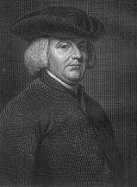
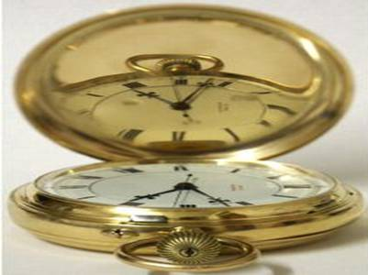
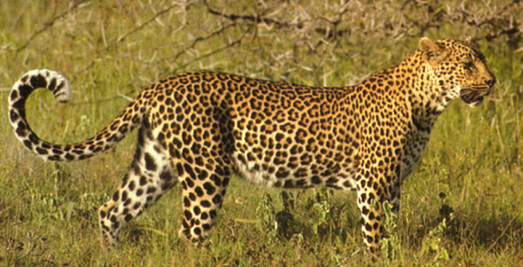
A God of the Gaps?
William Paley (1743-1805)
Suppose you find a stone on a heath
Maybe it has always been there
Suppose you find a watch on a heath
It is so complex, it must have been designed
Suppose you find living things
Much more complex than a watch
They must have been designed … by God

Slide 23
Analysis of Paley’s Argument
Complex structure and working of living beings needs explaining
This cannot be explained naturally
Therefore it must have been produced supernaturally
✔
Gap !
Filled in by Darwin (?)
✗ False Conclusion

Slide 24
The Problem Further Unmasked
Dawkins etc. see science and God as competing explanations
But maybe God uses science to create things
Laws of science explain how things happen
But where do the laws of science come from?
You still need God without Gaps!

Slide 25
Conclusion
The fool has said in his heart: “There is no God above.”
Ps 13(14):1
The heavens proclaim the glory of God and the firmament shows forth the work of his hands.
Ps 18(19):2
Ever since the creation of the world God’s invisible nature, namely, his eternal power and deity, has been clearly perceived in the things that have been made.
Rom 1:20
In the beginning was the Word [Logos], and the Word was with God, and the Word was God. He was in the beginning with God; all things were made through him, and without him was not anything made that was made.
Jn 1:1-3

Slide 26
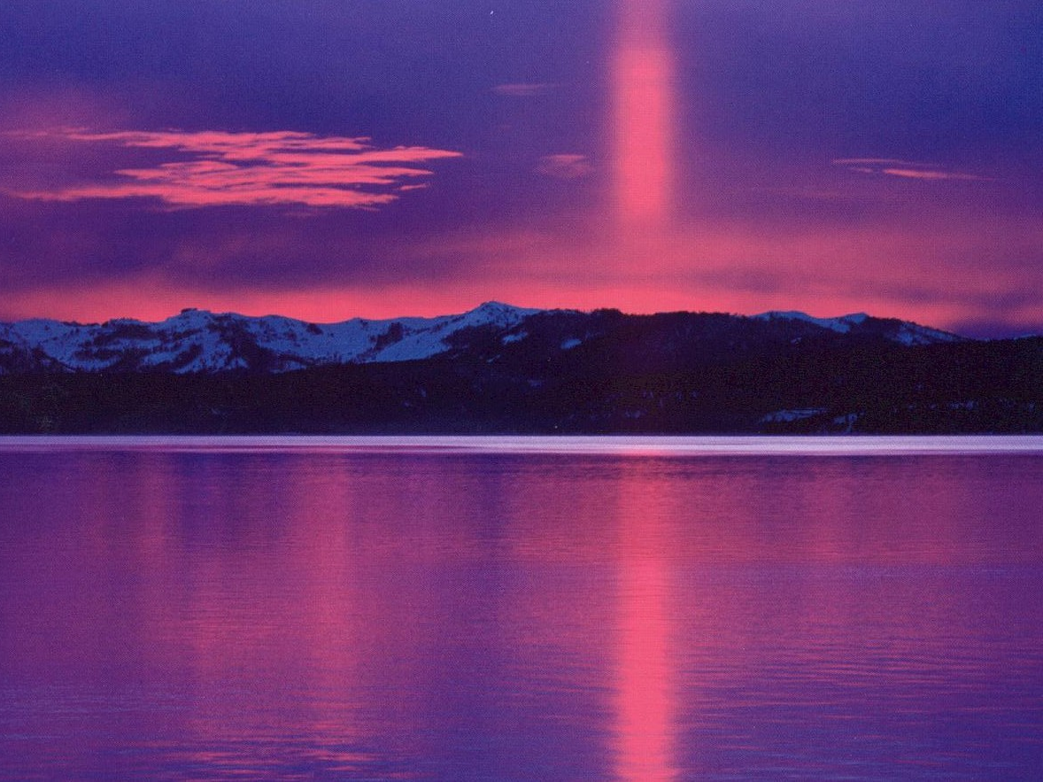
For all men who were ignorant of God were foolish by nature; and they were unable from the good things that are seen to know him who exists, nor did they recognise the craftsman while paying heed to his works; but they supposed that either fire or wind or swift air, or the circle of the stars, or turbulent water, or the luminaries of heaven were the gods that rule the world.

Slide 27
If through delight in the beauty of these things men assumed them to be gods, let them know how much better than these is their Lord, for the author of beauty created them. And if men were amazed at their power and working, let them perceive from them how much more powerful is he who formed them. For from the greatness and beauty of created things comes a corresponding perception of their Creator.

Slide 28
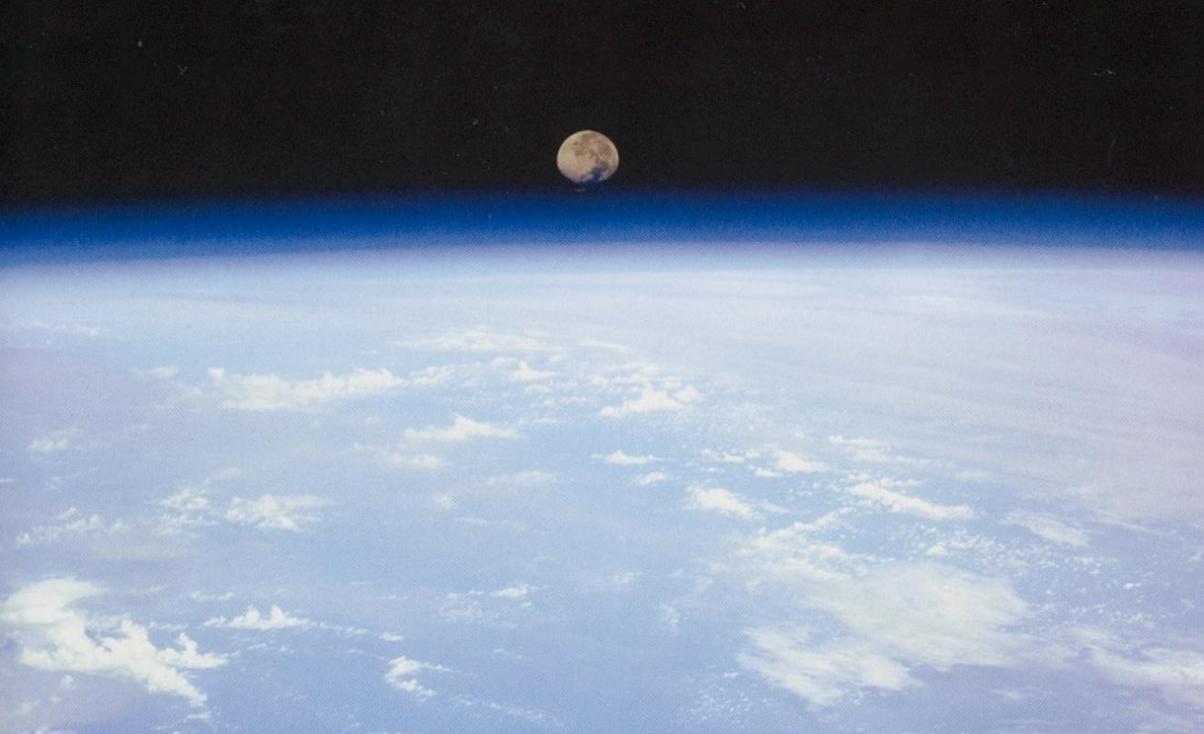
Yet these men are little to be blamed, for perhaps they go astray while seeking God and desiring to find him. For as they live among his works they keep searching, and they trust in what they see, because the things that are seen are beautiful. Yet again, not even they are to be excused; for if they had the power to know so much that they could investigate the world, how did they fail to find sooner the Lord of these things?

Slide 29
Ideas for Discussion
What struck you as interesting / annoying / challenging / exciting?
What do you agree with / disagree with?
How important are these questions for the mission of the Church today?

